Slide 1
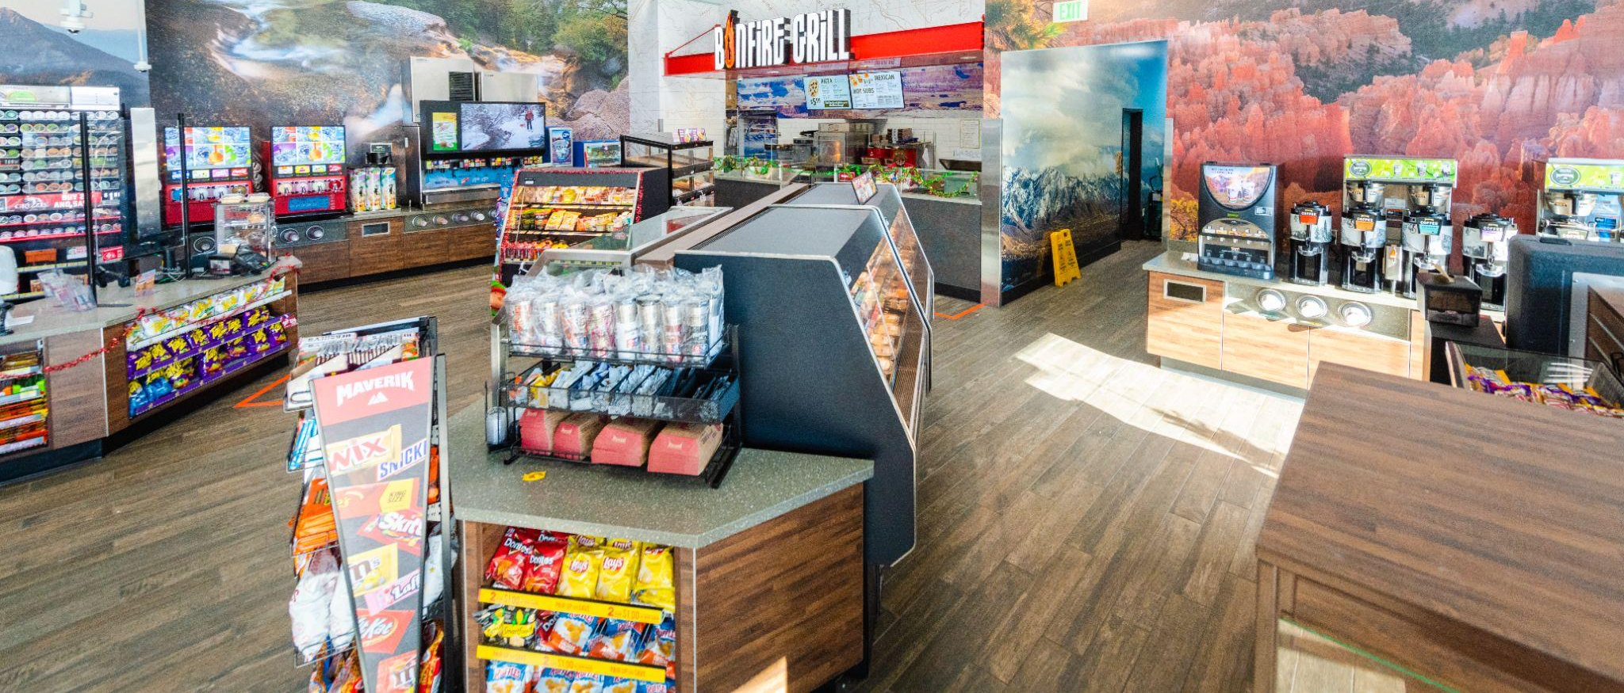
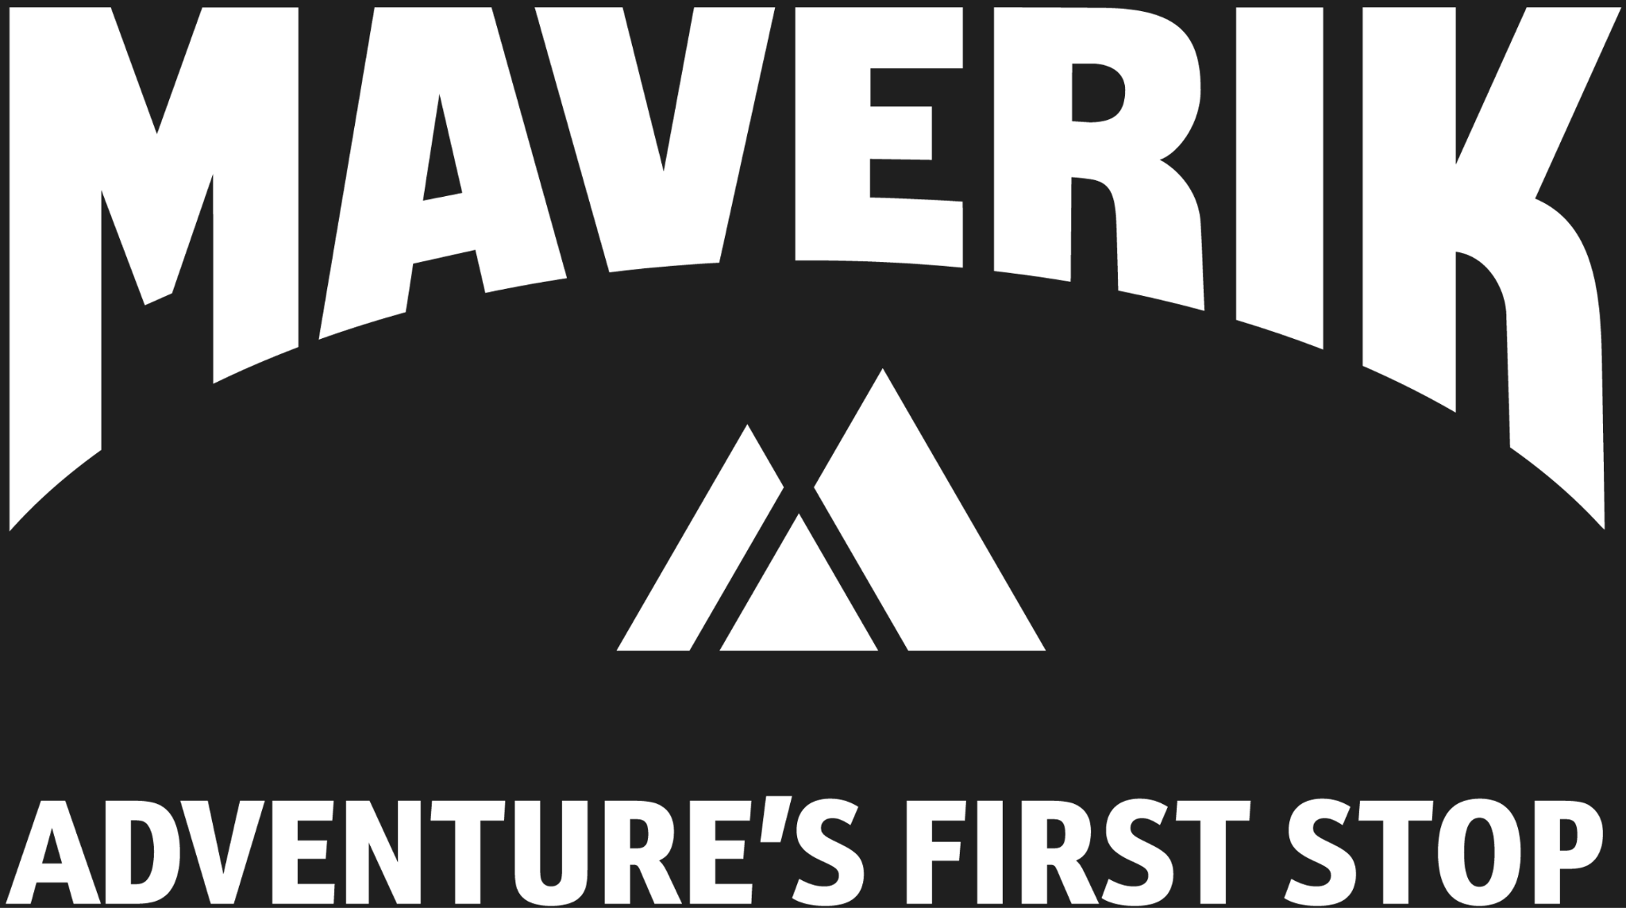
Forecasting New Store Sales

Slide 2


The Team
Top Gun: Maverik
Dominique Miranda
Jenisha Rawal
Dayton Murset
Andrew Moore

Slide 3
Business Problem
With a business plan of opening new stores every year, the projected performance of new stores is crucial to successful selection, opening, and continual operations of these new stores, while maintaining consistent growth at existing locations. Our team has been tasked with creating a forecasting model based on available data that will outperform the current naive model that has been running for several weeks.
Notes:
Dom

Slide 4
Results
Our team has been tasked with creating a forecasting model based on available data. These results include :
Projection of daily revenue at the store level for the following year
Forecast of the daily sales of specific items such as gasoline, diesel, in-store merchandise, in-store food
Actual sales of each store on a given day compared to what the model predicted.
Notes:
Dom

Slide 5
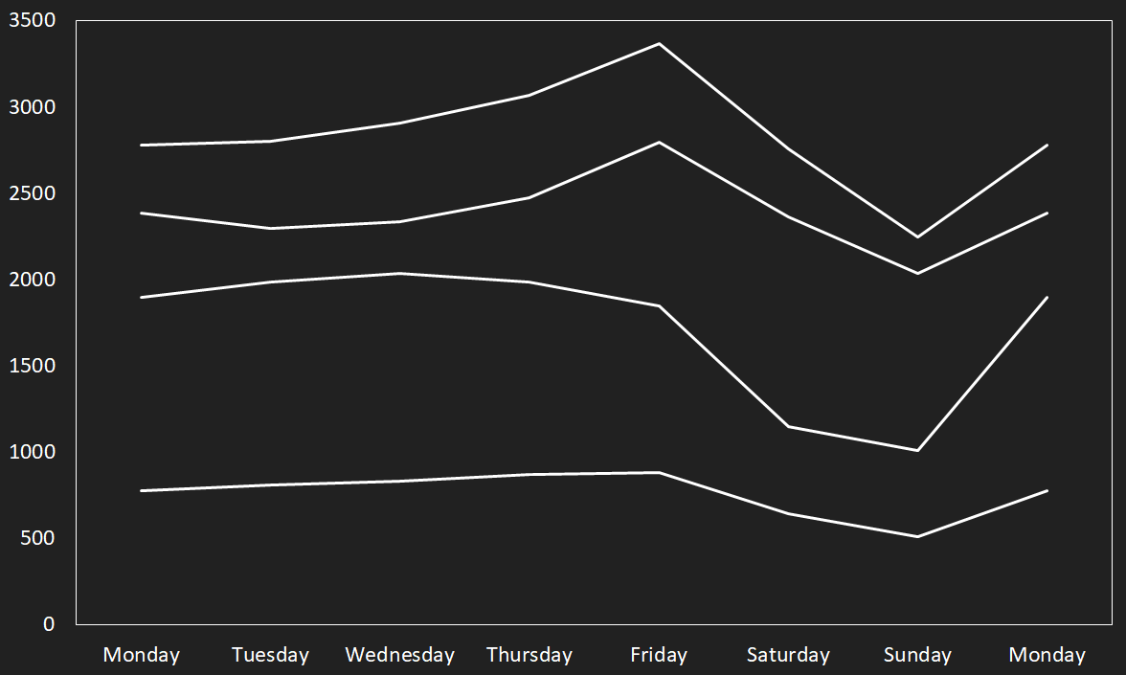
Weekly Trends
Weekly Sales Trends:
Amount of Sales ($ or gallons) vs Day of Week
Indoor
Unleaded
Diesel
Food
Day
Notes:
Jenisha

Slide 6
Weekly Trends
Weekly Sales Trends:
All items struggle on weekends after a strong Friday, diesel worst of all
Amount of Sales ($ or gallons) vs Day of Week
Indoor
33%
Unleaded
Diesel
27%
45%
Food
42%
Day
Notes:
Jenisha

Slide 7
Weekly Trends
Weekly Sales Trends:
All items struggle on weekends after a strong Friday, diesel worst of all
All items rebound on Monday
Amount of Sales ($ or gallons) vs Day of Week
24%
Indoor
Unleaded
Diesel
17%
88%
Food
53%
Day
Notes:
Jenisha

Slide 8
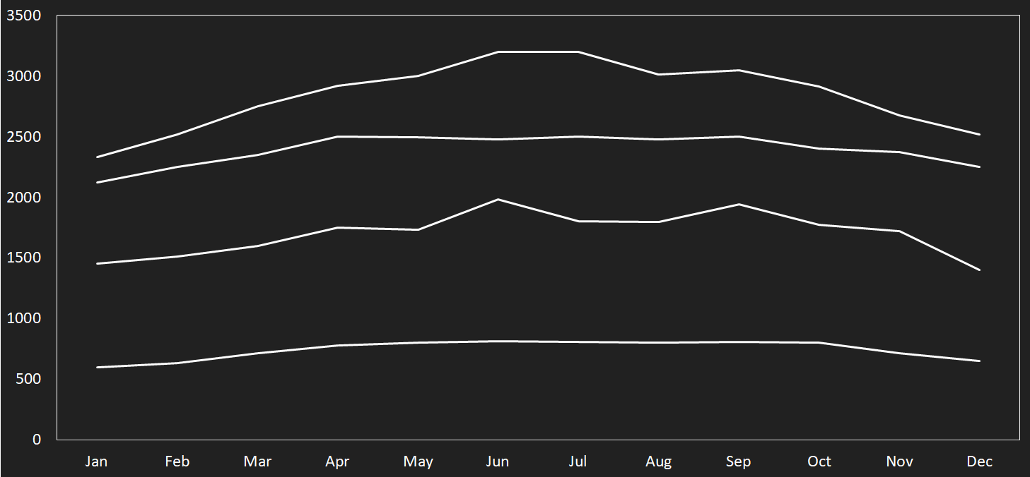
Seasonal Trends
Amount of Sales ($ or gallons) vs Month of Year
Indoor
Unleaded
Diesel
Food
Notes:
Summer is Maverik's peak sales season.
June and July: highest sales for food and inside
products.
Gas sales jump in April.
Useful for stocking and staffing plans.
Suggestion :
Stock Up : Prepare more inventory
Staffing : Schedule extra staff during peak months
Promotion : Consider special offers

Slide 9
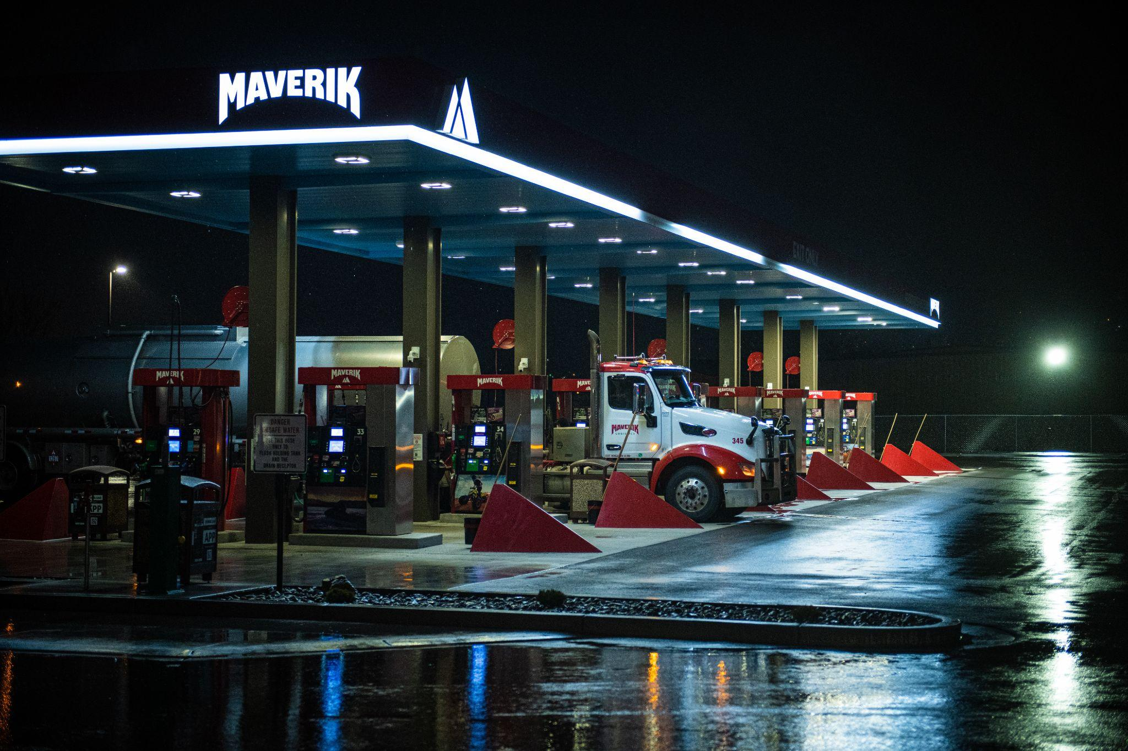
Notes:
The true strength of our model is in the feature engineering. Because our model relies heavily on lagged performance there is little need to create features that you do not have already available for your use.
We have a script that adjusts the dataset that was given in a way that it is able to run and preprocess for us.

Slide 10
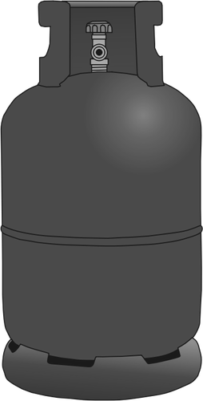
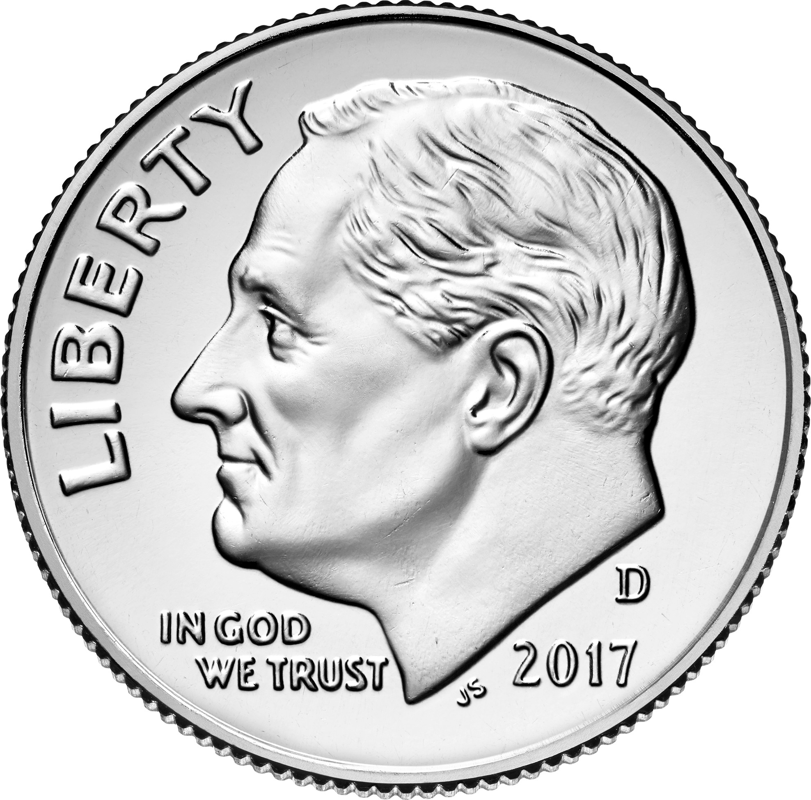
Model Performance
Notes:
How well does it do? Fresh out of a training session our model is within about 20 cents or .2 gallons depending on what category we are talking about.
Our RMSE values for all categories is below .20 and often is lower.

Slide 11
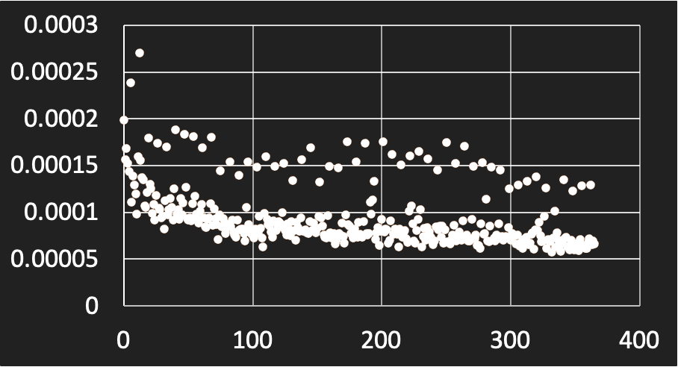
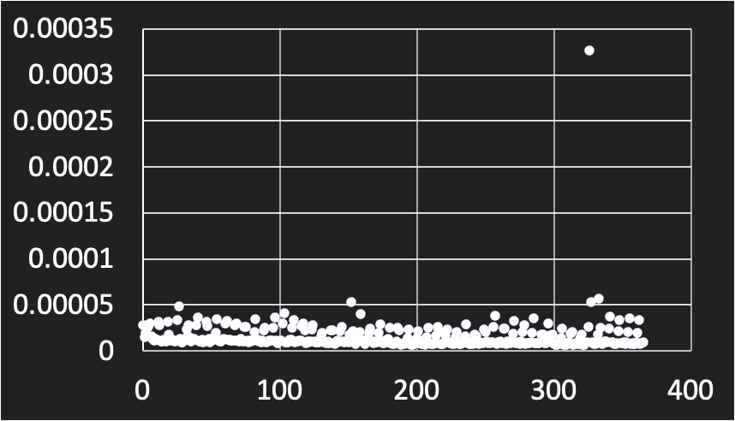
Model Performance
Absolute Percentage Error - Unleaded
Absolute Percentage Error - Diesel
APE
APE
Day of the Year
Day of the Year
Notes:
If you’re curious, here is a simulation run over an entire year. (This is a quick sim so we are not retraining).
This runs in under 2 seconds.

Slide 12
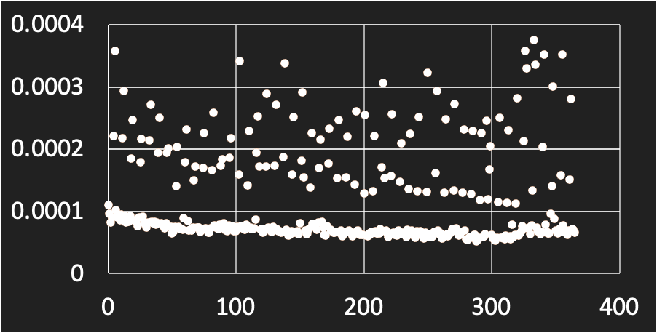
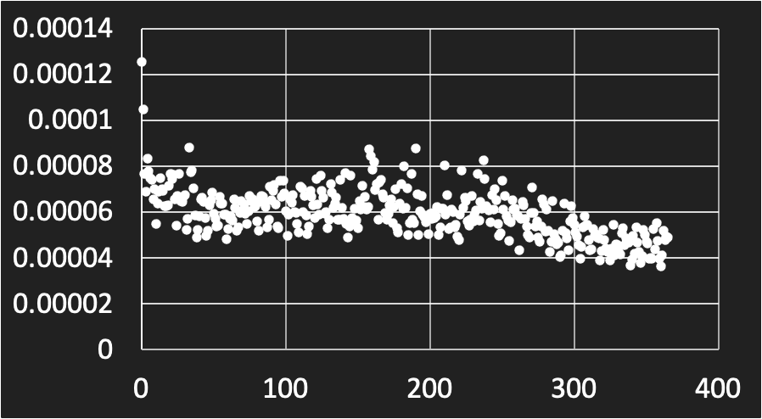
Model Performance
Absolute Percentage Error - Food
Absolute Percentage Error - Indoor
APE
APE
APE
Day of the Year
Day of the Year
Notes:
If you’re curious, here is a simulation run over an entire year. (This is a quick sim so we are not retraining).
Different stores randomly selected.
This runs in under 2 seconds.

Slide 13
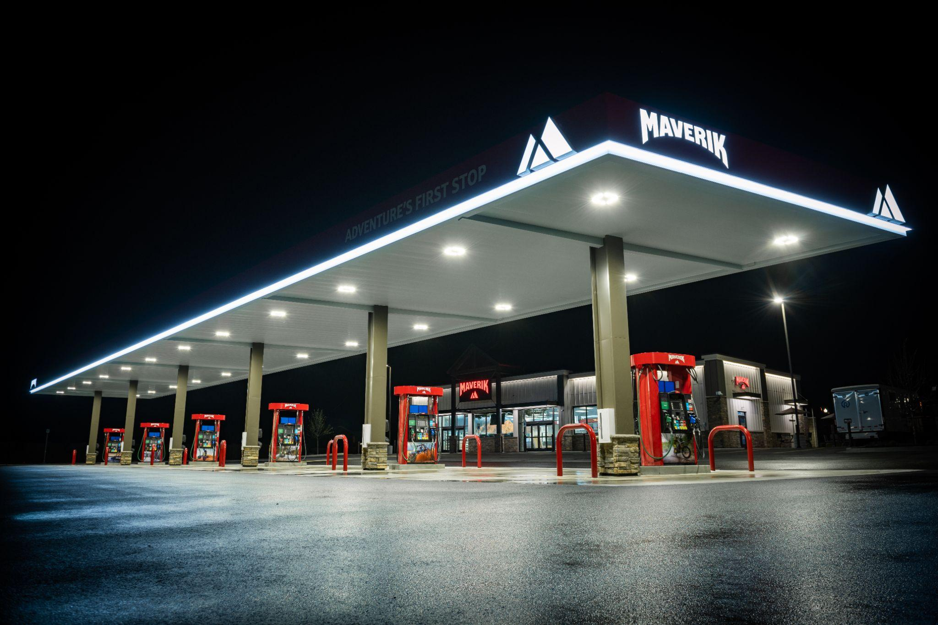
Further Features
Notes:
Our model has the ability to do both a full sim (with a retrain every day) or a quick sim when you need quick numbers depending on your needs.

Slide 14
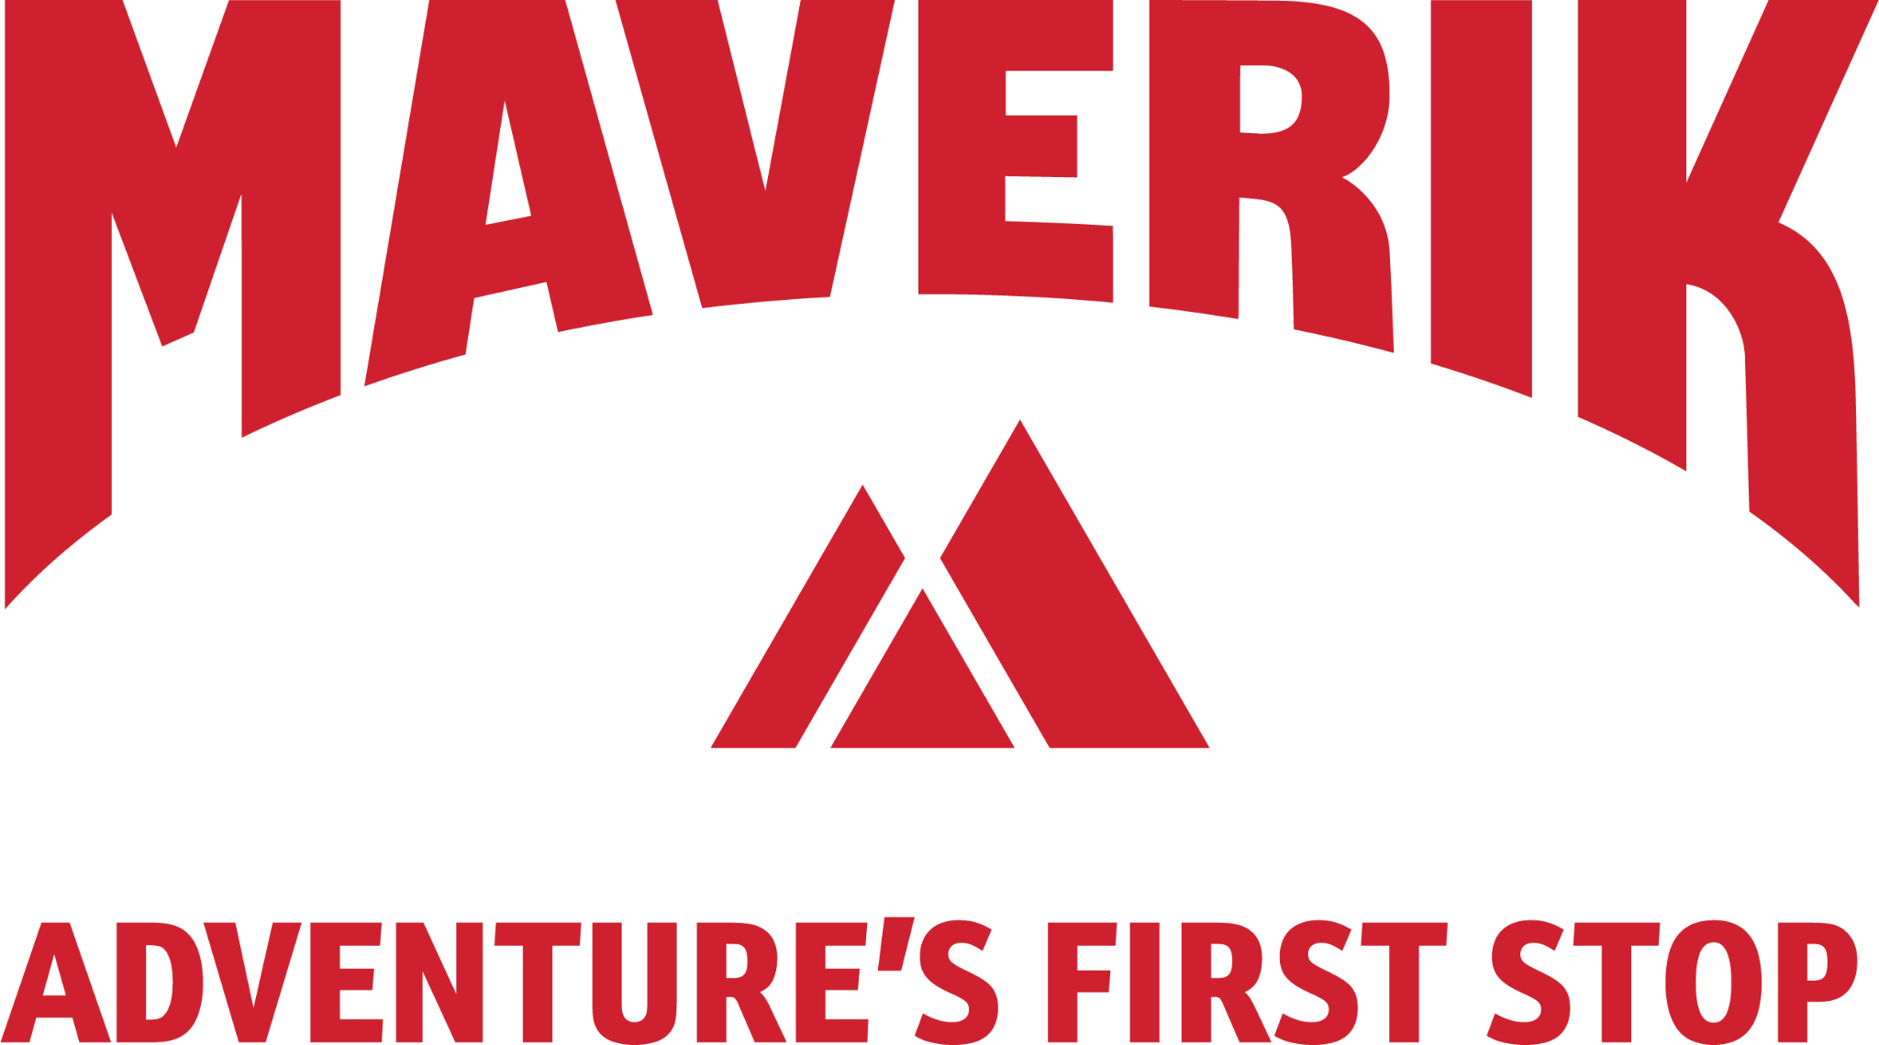

Future Use
Notes:
Because of how fast the quick sim runs a UI would be nice.
There would be a search bar for the new store, Predictions for the next week.
Other important key metrics like year end sales.
If more time: talk about the structure of how it runs.

Slide 15
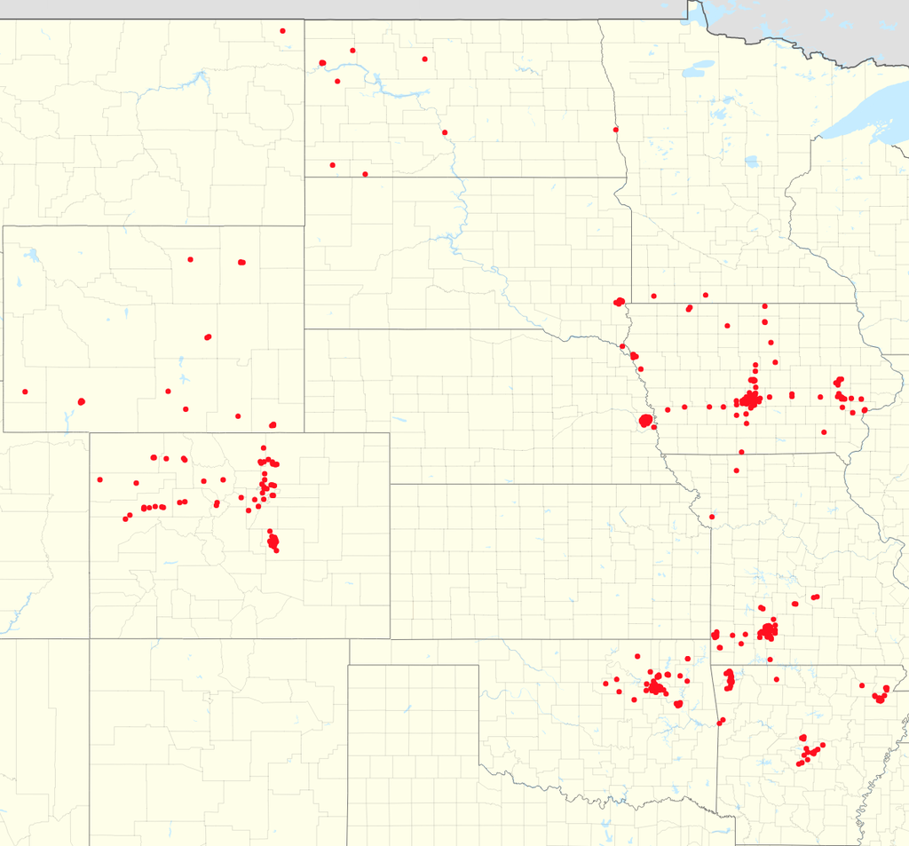

Business Impact
Notes:
Competitive landscape; expansion discussion
There are costs associated with opening a new store. One of the main costs is the analysis, shipping, and stocking of items. This hits all 4 product types provided by Maverik.
While it is impossible to predict future sales of products with 100% certainty, there is an expectation that this be predicted within 5%. Overpredicting leads to product that is difficult to sell, often leading to discounting and loss of margin. Underpredicting leads to the product being in demand but lacking supply.

Slide 16
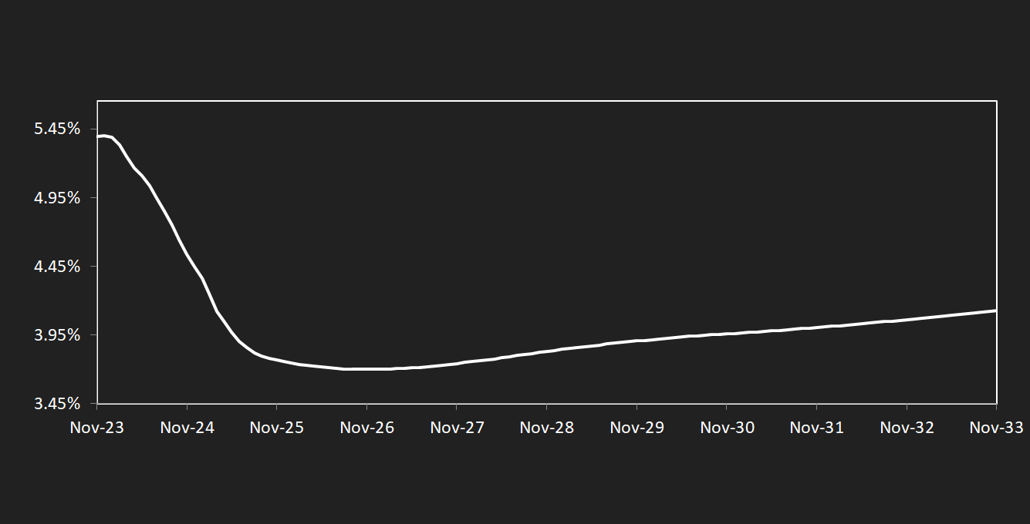
Business Impact
3 Month Term SOFR Forward Curve
Rate
Dec-23: 5.40%
Date
Current SOFR and 3-Month Forward Rate
Notes:
Without knowing the bottom line, it is difficult to predict exactly how much dollar impact there will be.
However
The current lending rate is for established businesses is roughly SOFR + 3-5 %. Right now, it is more expensive to borrow money than at any time in the 21st century.
Being able to accurately and quickly predict a store’s performance will determine how much money needs to be allocated to the opening of that store before sales increase to the expected level by management.
General consensus has the long term SOFR stabilizing around 4%. This means that every 1 million dollars that is being underallocated is costing maverik $5000 - $6000 a month. The rate will be slightly lower for over allocation but will still be costing Maverik a similar amount.
To conclude, being able to get the model within 5% of revenue predictions by product type as quickly as possible prevents Maverik from over or under sending product to stores thereby saving the cost of doing so and prevents the loss from lack of supply and the loss from discounting oversupplied items.
COSTS of lending/borrowing money DOWN
RISK of over/under lending/borrowing money DOWN

Slide 17
Business Impact
3 Month Term SOFR Forward Curve
Rate
3.70%
Date
Current SOFR and 3-Month Forward Rate
Notes:
Without knowing the bottom line, it is difficult to predict exactly how much dollar impact there will be.
However
The current lending rate is for established businesses is roughly SOFR + 3-5 %. Right now, it is more expensive to borrow money than at any time in the 21st century.
Being able to accurately and quickly predict a store’s performance will determine how much money needs to be allocated to the opening of that store before sales increase to the expected level by management.
General consensus has the long term SOFR stabilizing around 4%. This means that every 1 million dollars that is being underallocated is costing maverik $5000 - $6000 a month. The rate will be slightly lower for over allocation but will still be costing Maverik a similar amount.
To conclude, being able to get the model within 5% of revenue predictions by product type as quickly as possible prevents Maverik from over or under sending product to stores thereby saving the cost of doing so and prevents the loss from lack of supply and the loss from discounting oversupplied items.
COSTS of lending/borrowing money DOWN
RISK of over/under lending/borrowing money DOWN

Slide 18
Q&A
Current SOFR and 3-Month Forward Rate
Notes:
Without knowing the bottom line, it is difficult to predict exactly how much dollar impact there will be.
However
The current lending rate is for established businesses is roughly SOFR + 3-5 %. Right now, it is more expensive to borrow money than at any time in the 21st century.
Being able to accurately and quickly predict a store’s performance will determine how much money needs to be allocated to the opening of that store before sales increase to the expected level by management.
General consensus has the long term SOFR stabilizing around 4%. This means that every 1 million dollars that is being underallocated is costing maverik $5000 - $6000 a month. The rate will be slightly lower for over allocation but will still be costing Maverik a similar amount.
To conclude, being able to get the model within 5% of revenue predictions by product type as quickly as possible prevents Maverik from over or under sending product to stores thereby saving the cost of doing so and prevents the loss from lack of supply and the loss from discounting oversupplied items.
COSTS of lending/borrowing money DOWN
RISK of over/under lending/borrowing money DOWN

